Slide 1
High Level Video Coding Overview and Basics of Scalable Video Coding

Slide 2
Training Objectives
At the conclusion of this training, you will be able to:
Define the following videoconferencing terms:
SVC
AVC
Encoding/Decoding
Know the benefits of Vidyo’s application of H.264 SVC vs. traditional AVC based videoconferencing solutions.
Understand as to how RateControl, Graceful Degradation and RateShaping functions in Vidyo SDK Dynamically Adapts to User Environment.
How Vidyo’s superior algorithm make our products more resilient to errors in impaired networks
How to make use of stats page in clients to debug some of video quality issues
Explain bandwidth utilization for Various Resolutions and how PACE feature works in Vidyo Clients
Notes:
Video 1

Slide 3





What Vidyo does and competitors can’t do easily:
1. Thanks to SVC, we can Dynamically Adapt to User Environment
High Resolution Layer
Base Layer
2 Mbps
High Resolution - High Frame Ra
Source
High Resolution - High Frame Rate
High Resolution Layer
High Resolution Layer
Base Layer
Base Layer
500 Kbps
Medium Resolution - Medium Frame Rate
Medium Resolution - Medium Frame Rate
Base Layer
3G/4G
Low Bandwidth
Low Resolution - Low Frame Rate
Low Resolution - Low Frame Rate
Vidyo’s Adaptive Video LayeringTM does not require network decision
Notes:
Video 1

Slide 4
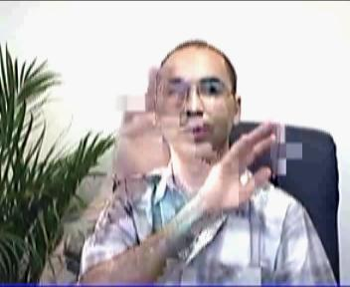
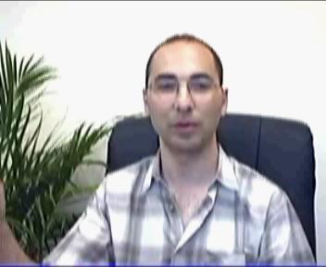
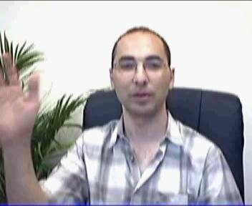
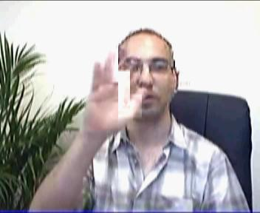
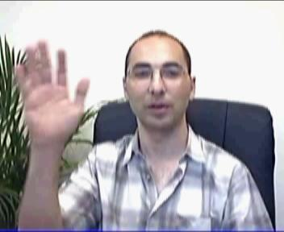
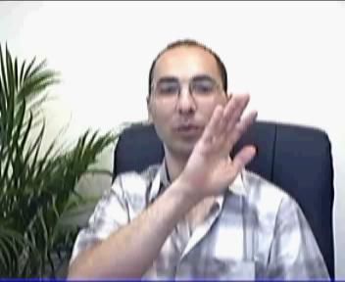
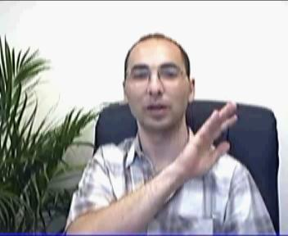
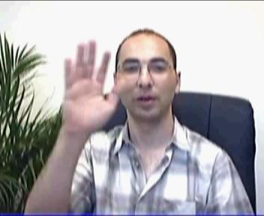
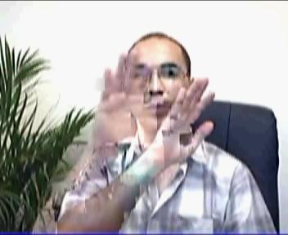
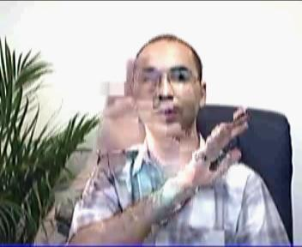
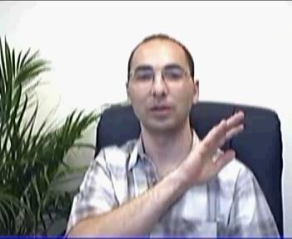

AVC (Single Layer) vs SVC (Multi-layer)
Significant Impact
Single Layer (AVC)
Multi-layer (SVC)
Minor or No Impact
Enhancement Layer
Base Layer
Notes:
Video 1

Slide 5
Basics of Encoding

Slide 6
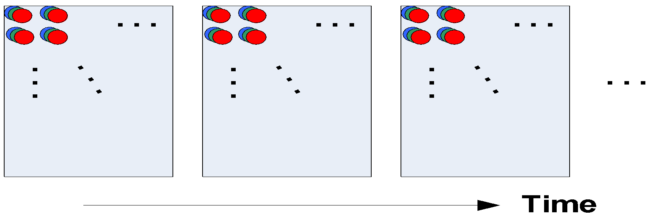
What Is a Digital Video Signal?
A natural visual scene is continuous:
Temporally
Spatially
Brightness and color-wise
So likewise. a digital video signal is a sampled representation of a natural visual scene: temporally, spatially, pixel-wise
A scene sampled at a point in time is called a frame (or a field) – a picture or an image
A frame consists of spatial samples called pixels (picture element)
Each pixel is represented by a set of values (typically 8-bit representation for each value)

Slide 7
RGB Pixel Representation
The three additive primary colors of light
A camera filters the R, G and B components of the scene and captures each with a separate sensor array
CRTs and LCDs display RGB images by separately illuminating the R, G and B components of each pixel
Intensity of each component is typically represented by a byte (24 bits/pixel)
Vidyo Proprietary Confidential & Patent Pending Information

Slide 8
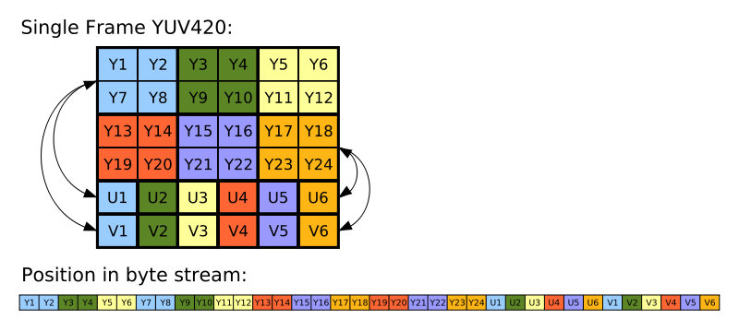
YUV or YCbCr Pixel Representation
Compatible with both black and white and color TVs
Used by currently deployed color TV standards
NTSC, PAL, SECAM, etc.
Used as the standard color format for common video compression algorithms:
H.26x and MPEG
Takes advantage of the fact human visual system is less sensitive to color than to luminance
Cb and Cr components can be represented in smaller resolution than the Y component
Cb and Cr can be compressed differently from the Y
In YUV codes a color image or video taking human perception into account
Vidyo Proprietary Confidential & Patent Pending Information

Slide 9
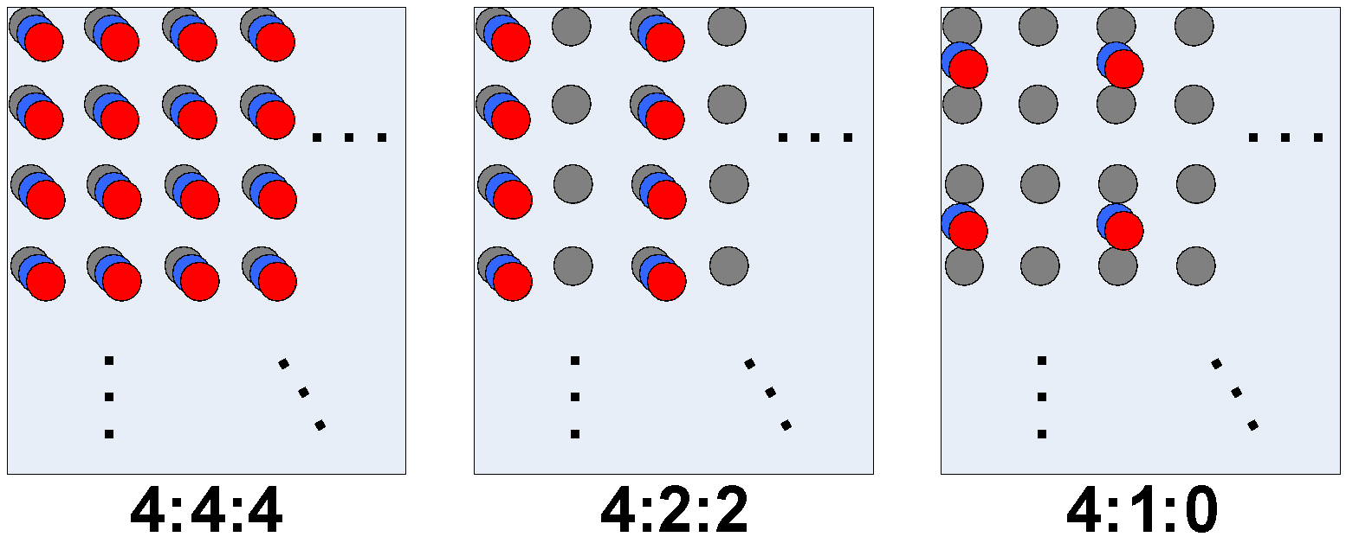
YUV Formats
4:4:4 – 24 bits/pixel: for 4 Y samples, 4 Cb and Cr samples
4:2:2 – 16 bits/pixel: for 4 Y samples, 2 Cb and Cr samples
4:2:0 – 12 bits/pixel: for 4 Y samples, 1 Cb and Cr samples
4:2:0

Slide 10
Why Compress?
Bandwidth required to send a Frame of a Common Interface Format (CIF) image
Resolution: 352 x 288 pixels
Using RGB color format to represent each pixel: 352 x 288 x 3 x 8 = 2.43 Mbits
With a 56 Kbps connection: 43 s
Video, using YUV 4:2:0
Format | Width | Height | FPS | Bandwidth Reqd. if there was no compression
Standard Video Conferencing@CIF | 352 | 288 | 30 | 36Mbps
Standard Video Broadcast@SD resolution | 720 | 480 | 30 | 124Mbps
Vidyo Conferencing@360P30 | 640 | 360 | 30 | 83Mbps
HD Vidyo Conferencing@720P30 | 1280 | 720 | 30 | 332Mbps
HD Vidyo Conferencing@1080P60 | 1920 | 1080 | 60 | 1.5Gbps

Slide 11
Basic Image Coding Tools
Entropy coding (Huffman)
Quantization
Scalar
Vector
Transform coding
Block-based discrete cosine transform (DCT) is the most widely used

Slide 12
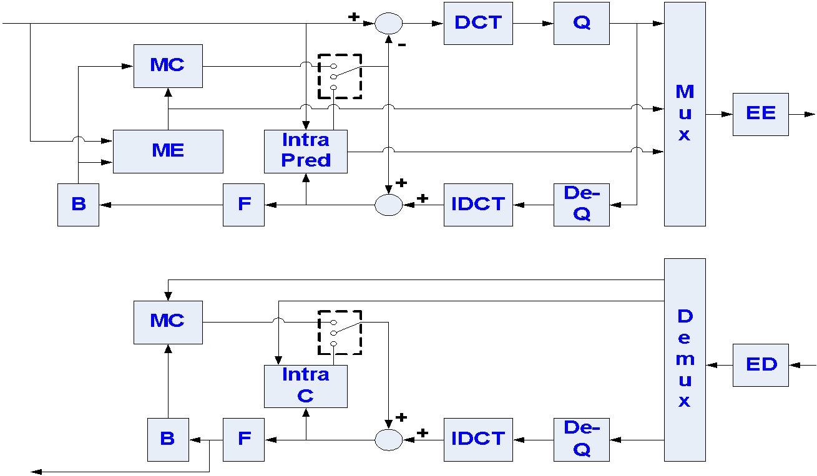
H.264 Codec

Slide 13
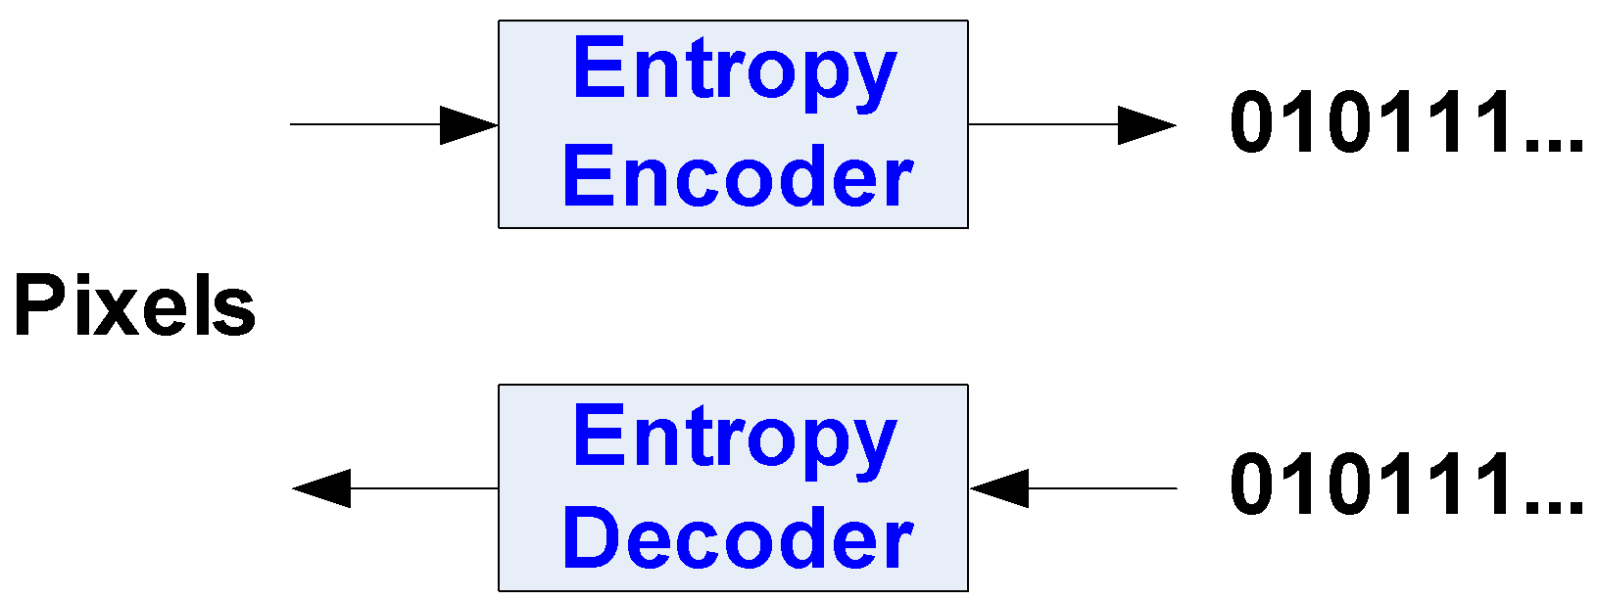
Compression

Slide 14
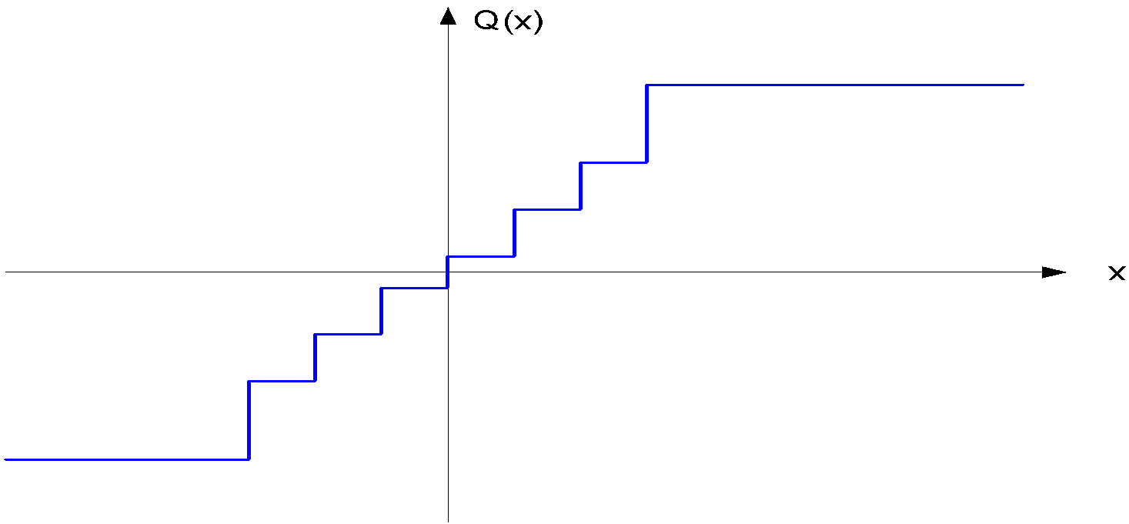
Scalar Quantization
Quantize each sample in a source signal to one of the reconstruction values in pre-designed reconstruction codebook

Slide 15
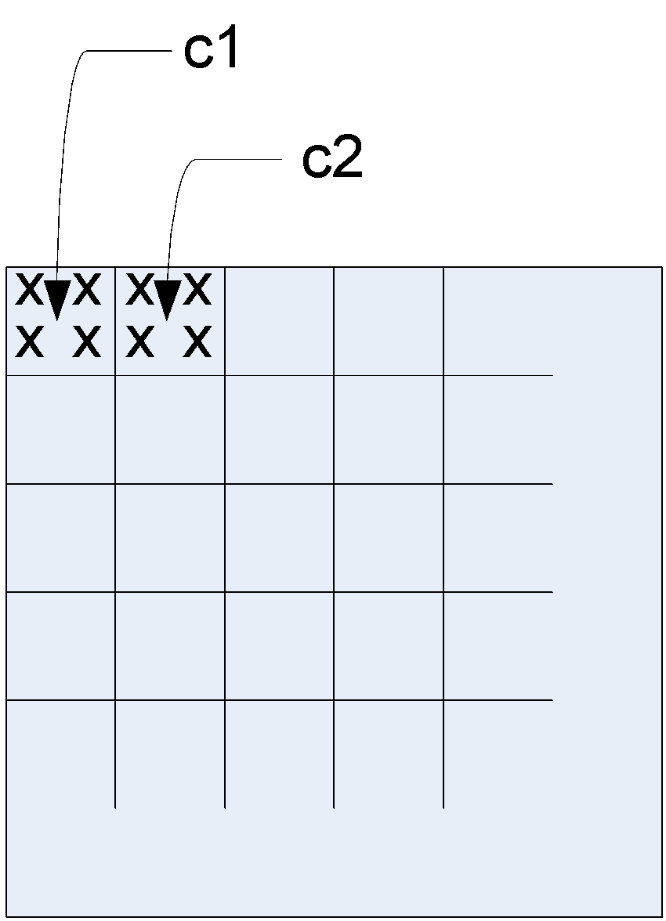
Vector Quantization
Quantize a group of samples (a vector) together
In image/video coding, a vector usually corresponds to a square block of pixels
Samples in a block are usually correlated
Efficiency increases as the vector dimension increases
However computational complexity and storage requirement grow exponentially with the vector dimension

Slide 16
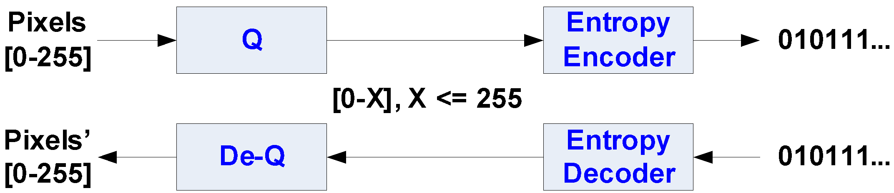
Compression
Scalar quantization can be applied without loosing too much in coding efficiency compared to vector quantization

Slide 17

Problem with Block-Based coding with Quantization
If heavily quantized, the block boundaries get pronounced
Blocking artifact

Slide 18
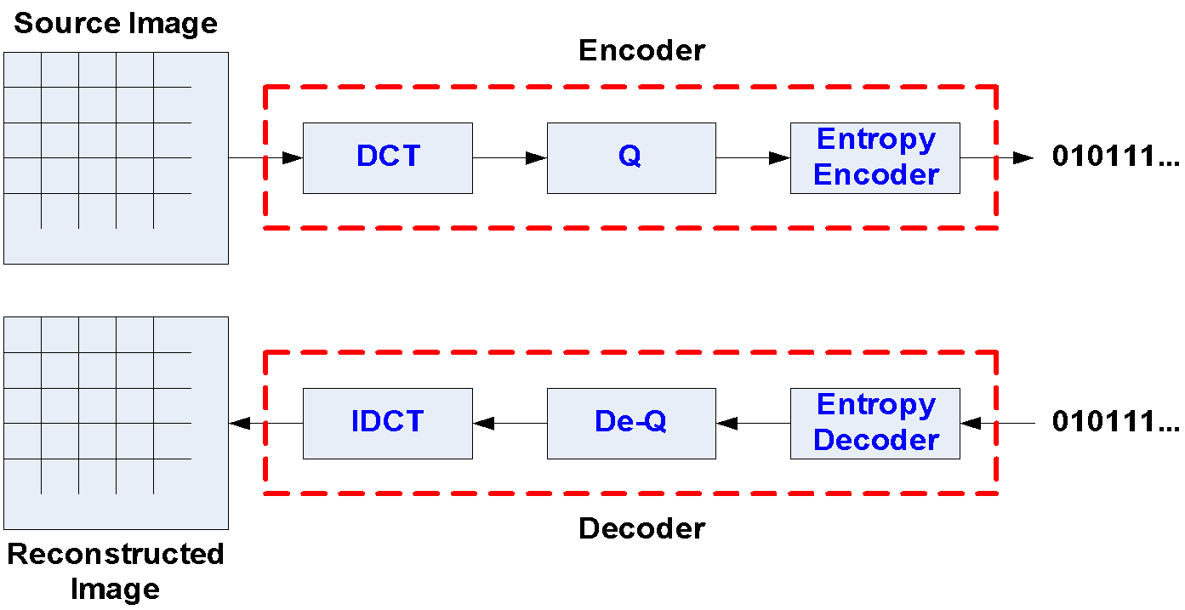
Compression

Slide 19
JPEG Results
Quality guidelines for JPEG system
0.25-0.50 bits/pixel: moderate to good quality
0.50-0.75 bits/pixel: good to very good quality
0.75-1.50 bits/pixel: excellent quality
1.50-2.50 bits/pixel: usually indistinguishable from original
After applying all this compression, Bandwidth Reqd. with image compression
Format | Width | Height | FPS | Bandwidth Reqd.
Standard Video Conferencing@CIF | 352 | 288 | 30 | 7.6Mbps
Standard Video Broadcast@SD resolution | 720 | 480 | 30 | 25.9Mbps
Vidyo Conferencing@360P30 | 640 | 360 | 30 | 17.3Mbps
HD Vidyo Conferencing@720P30 | 1280 | 720 | 30 | 69.1Mbps
HD Vidyo Conferencing@1080P60 | 1920 | 1080 | 60 | 311 Mbps

Slide 20
Basic Video Coding Tools
Entropy coding (Huffman)
Quantization
Scalar
Vector
Transform coding
Motion estimation (ME)
Block-based ME

Slide 21
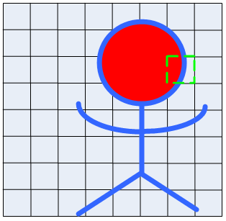
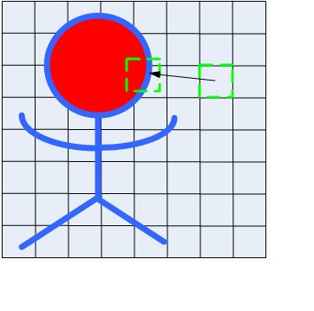
Block-Based ME
The estimation of motion information (parameters)
Assume all pixels in a block undergo a coherent motion
Assume translational motion: one motion vector (MV) per block
Estimate the MV by minimizing the difference between current block and reference block

Slide 22
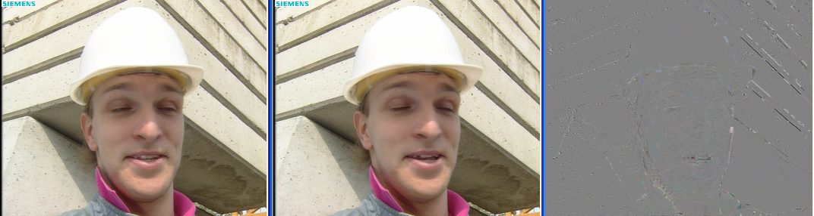
ME – Residue after Inter Prediction
Current picture – Previously encoded picture (MC picture) = Residue picture
Notes:
dfgksdfaklkljldfkladfkadfklkl

Slide 23
As per H264 AVC standards, other than an I Frame, each frame has reference to previous frame
Each frame depends on the former one, loss can’t be tolerated
Rate shaping, change of resolution requires complex HW and introduce delay
Encoded bit stream is less resilient to errors in the newotk
S0
S0
S0
S0
S0

Slide 24
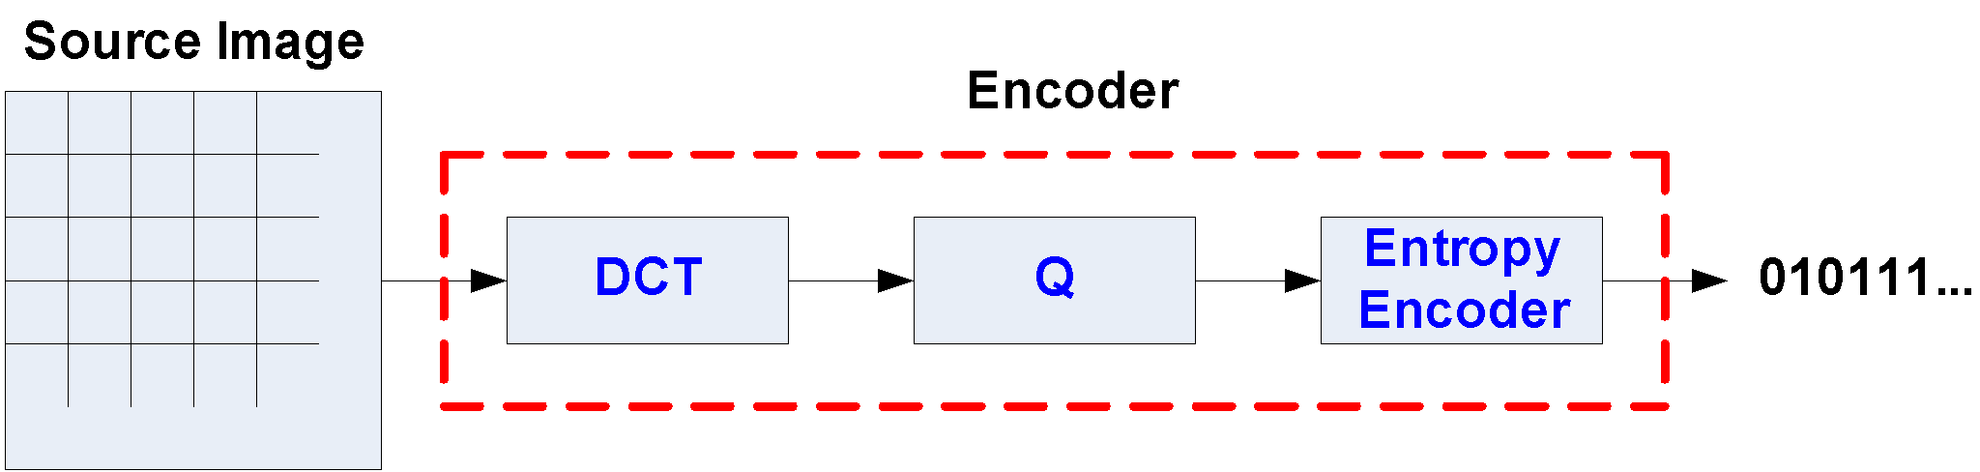
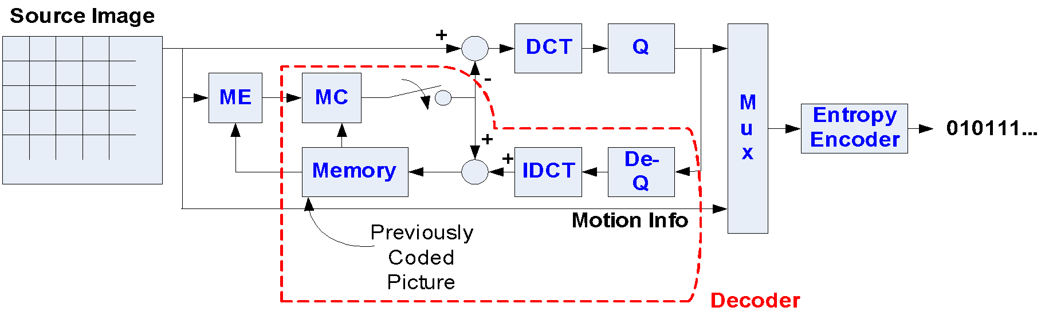
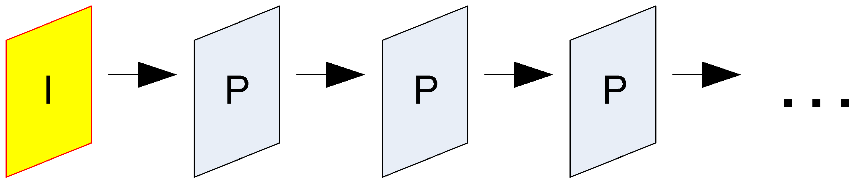
Video Compression
I/Intra picture (image coding – e.g., JPEG)
P/Inter picture (using ME)

Slide 25
Vidyo’s SVC Video Compression
Video compression standards are used to compress the video that is transmitted during a videoconference
Vidyo uses the superior compression method, SVC, to achieve high quality, resilient and natural telepresence experiences
H.264/MPEG-4 AVC (Advanced Video Coding) compression uses a single, and less resilient, video stream that is sensitive to bandwidth fluctuations and packet loss
H.264/MPEG-4 SVC (Scalable Video Coding) compression uses multiple layers (Vidyo uses up to three). Each layer’s frame rate, quality and resolution can be adjusted in real-time in response to bandwidth fluctuations, packet loss and/or available CPU resources
Notes:
Video 1
H.264/MPEG-4 AVC (Advanced Video Coding) is a standard for video compression, and is currently one of the most commonly used formats for videoconferencing and distribution of HD video. The final drafting work on the first version of the standard was completed in May 2003.
H.264/MPEG-4 SVC (Scalable Video Coding) is the name for the Annex G extension of the H.264/MPEG-4 AVC video compression standard. SVC standardizes the encoding of a high-quality video bitstream that also contains one or more subset bitstreams. A subset video bitstream is derived by dropping packets from the larger video to reduce the bandwidth required for the subset bitstream. The subset bitstream can represent a lower spatial resolution (smaller screen), lower temporal resolution (lower frame rate), or lower quality video signal. The SVC project received final approval

Slide 26
Scalable Video Coding
SVC spects are defined in Annex G extension of the H.264/MPEG-4 AVC video compression standard
Encoding of video signal with different resolution scales that helps a decoder to decode selectively only part of the coded bitstream
Scalability can be in the form of Temporal scalability: Temporal subsampling where encoded stream consists of one or more subset bitstreams.
Spatial scalability: spatial subsampling
Vidyo Proprietary Confidential & Patent Pending Information

Slide 27
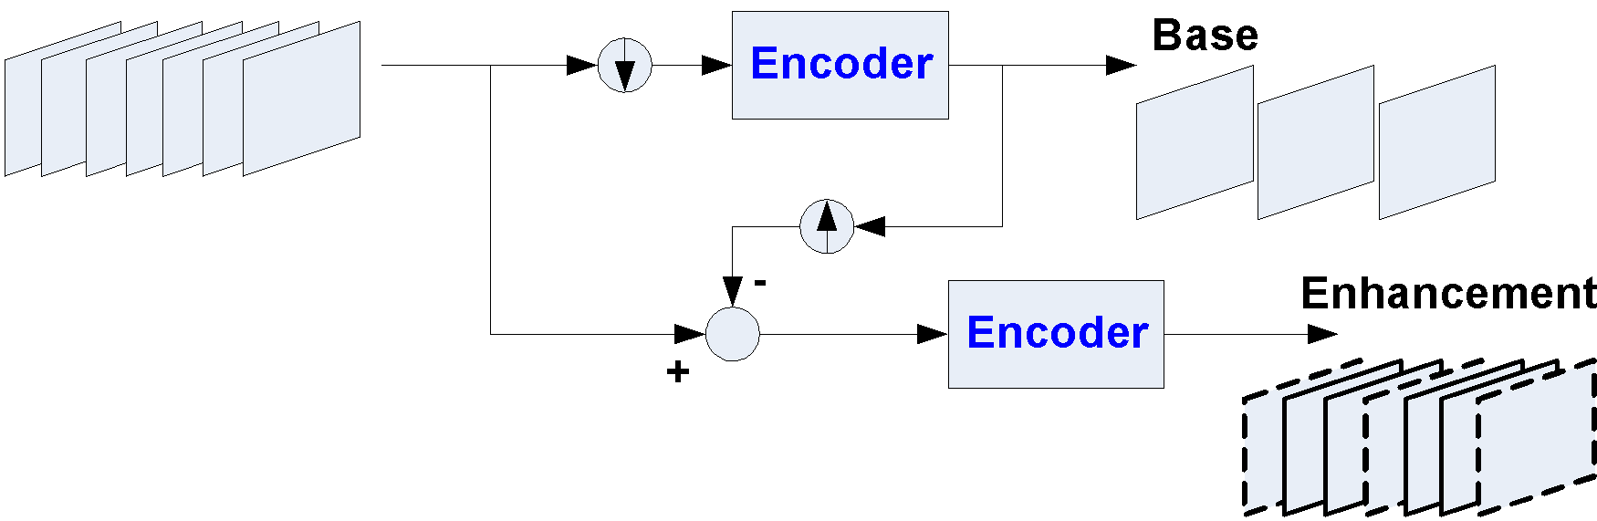
Temporal Scalable Coding
Temporal downsampling with temporal anti-alias filter or by frame skipping
Temporal upsampling by MC prediction

Slide 28
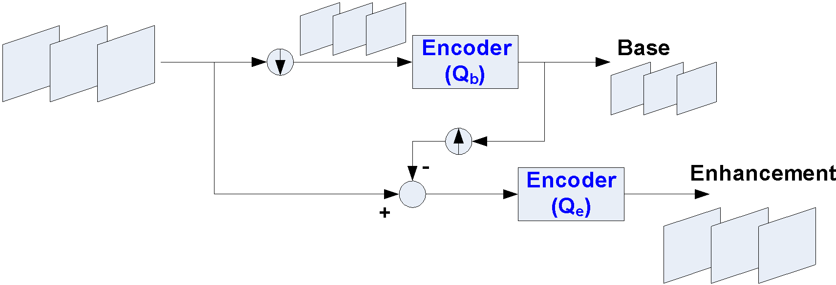
Spatial Scalable Coding
Base to enhance prediction

Slide 29
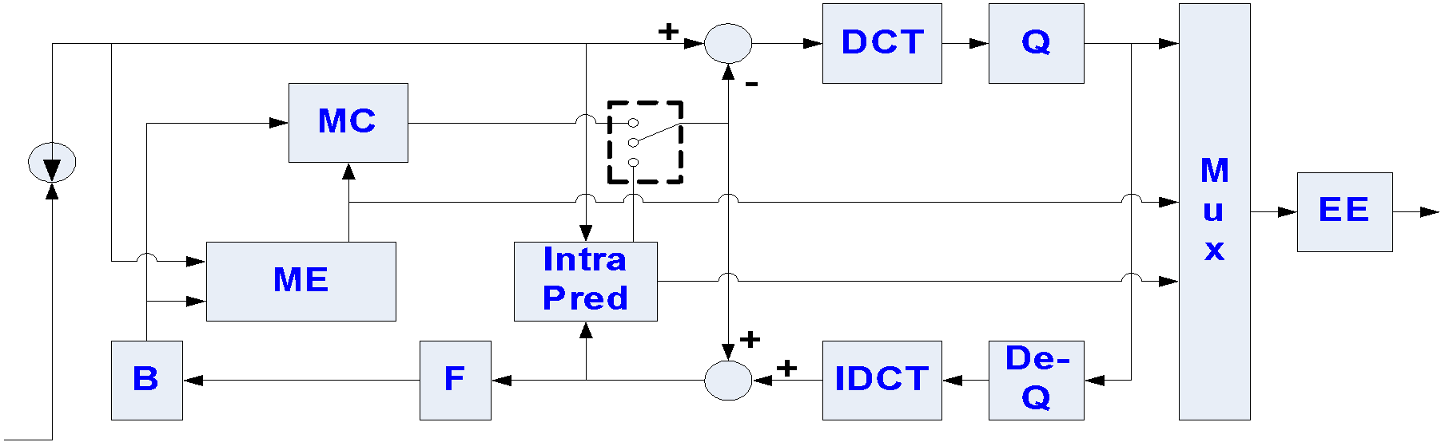
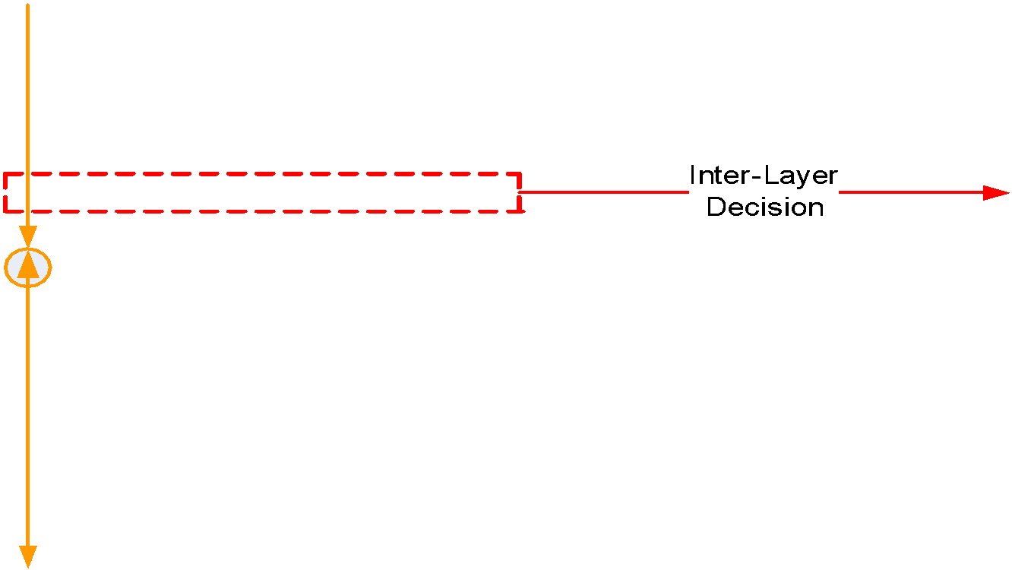
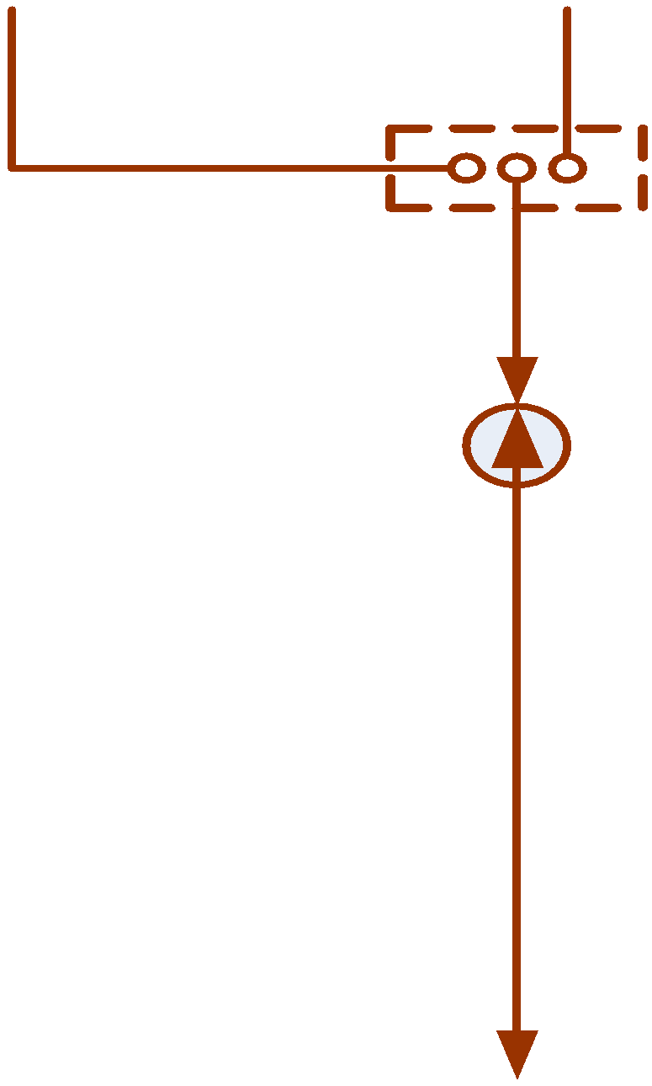
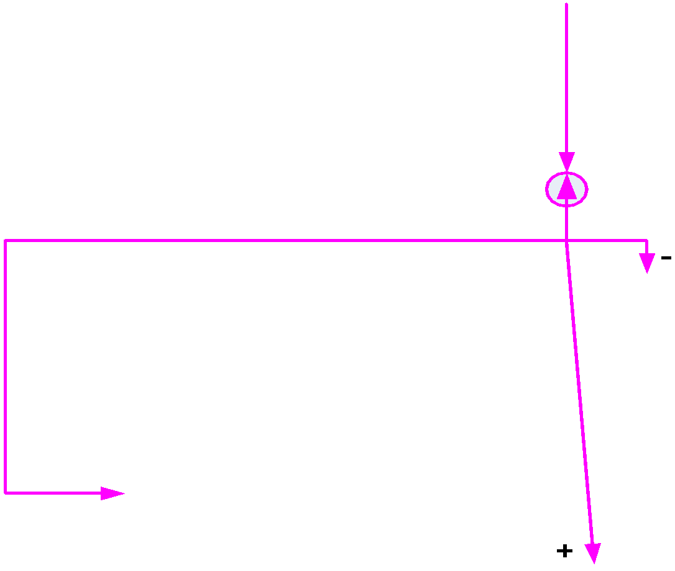
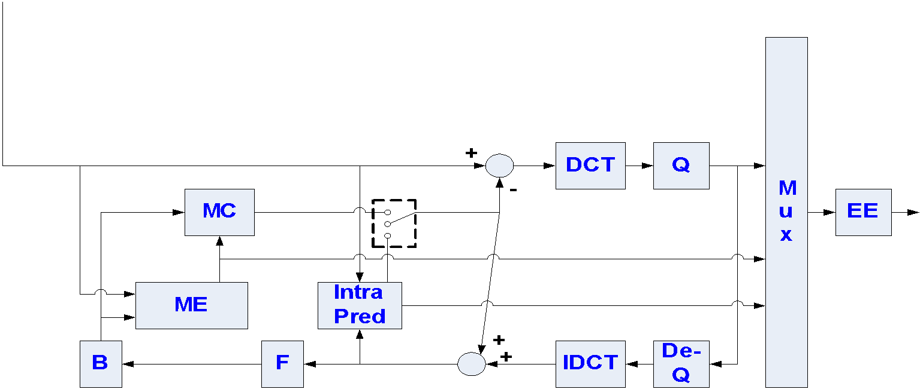
Spatial Scalable Encoder
Vidyo Proprietary Confidential & Patent Pending Information

Slide 30
As per H264 SVC standards, Temporal Modes as 0-3-2-3-1-3-2-3...
Quality is built from multiple layers, gracefully degrading with packet loss
Rate shaping, change of resolution are done by ‘layer routing’ – no HW and no delay
S3
S3
S3
S3
S2
S2
S0
S0
L3
L3
L3
L3
L2
L2
L0
L0

Slide 31
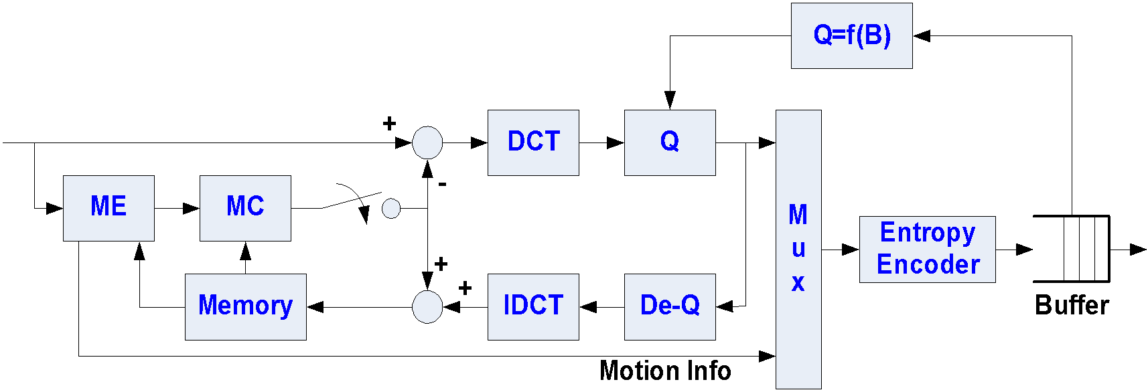
Rate Control

Slide 32
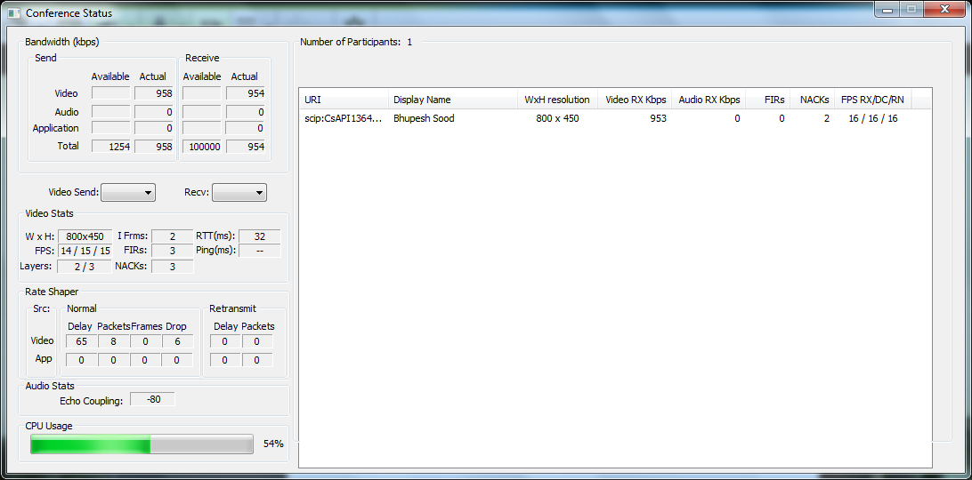
Multi Layers Encoding in Vidyo SDK
Depeneding on Uplink Bandwidth CPU usage, vidyo’s SVC compression uses multiple layers .
Under normal condition, and by default it starts with 2 Spatial Layers encoding
While in the call, and depending on Tx/Rx bandwidth, it can be either1, 2 or max 3 in Vidyo products
Temporal Layers. Always 3 in Vidyo products.

Slide 33
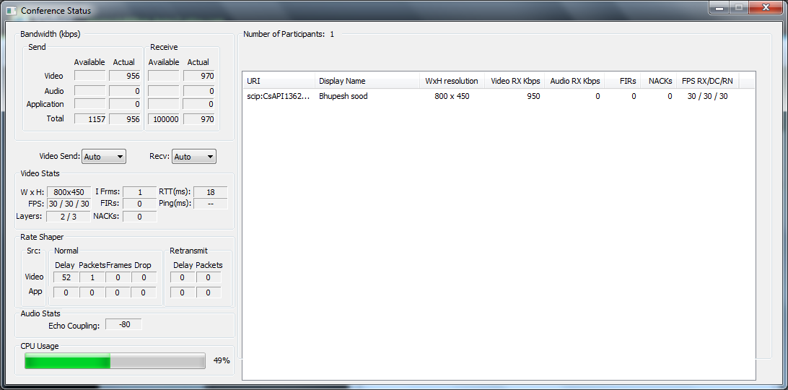
Multi Layers Encoding in Vidyo SDK
Both Tx and Rx Bandwidth > Reqd bandwidth to send all layers
There is enough CPU horse power available. Camera does support 450P30 and lighting conditions are right.
VidyoRouter sends Base and Enhance of temporal/spatial layers to the recipient with ample bandwidth
Encoder decides to encode 2 spatial layers and 3 temporal layers@450P as per user configuration.
No Downsampling and ALL 30 captured frame are encoded and transmitted on wire
So capturer captures and reports full 30 frames as per user configuration

Slide 34
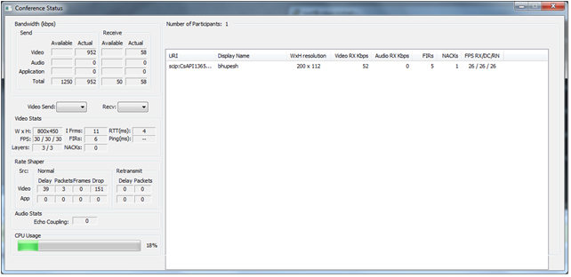
Multi Layers Encoding in Vidyo SDK
PACE support in product 2.X
3 Spatial, 3 Temporal Layers Encoding
Rx bandwidth is limited, causing PACE to be invoked
Encoder switches to encoding to 3 layers, IMMEDIATELY.

Slide 35
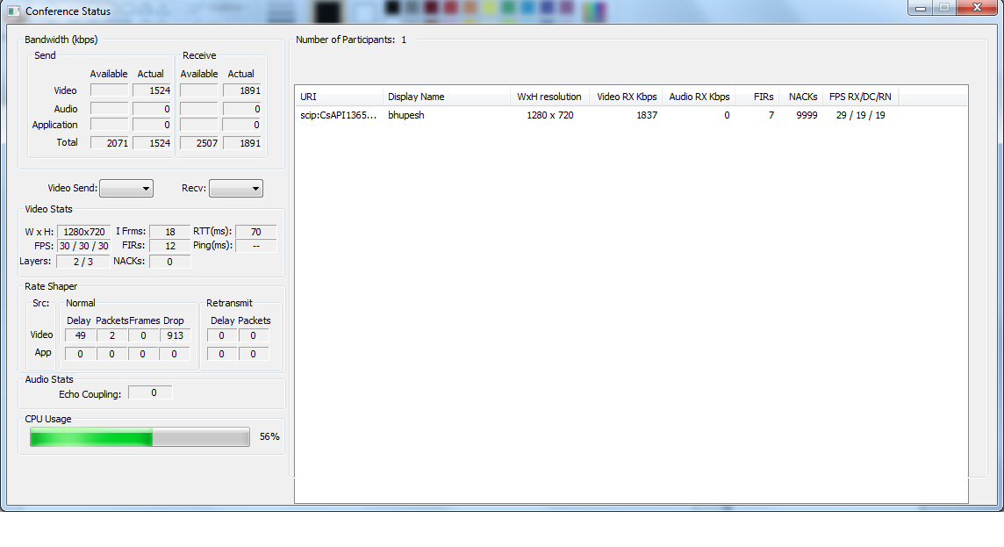
Errors in Rx Link
Delays/Jitter in Network
Almost all frame are received.
All received frames are not decoded or rendered.
Continuously increasing Nacking/FIRs count is an indication of errors/jitter in the network

Slide 36
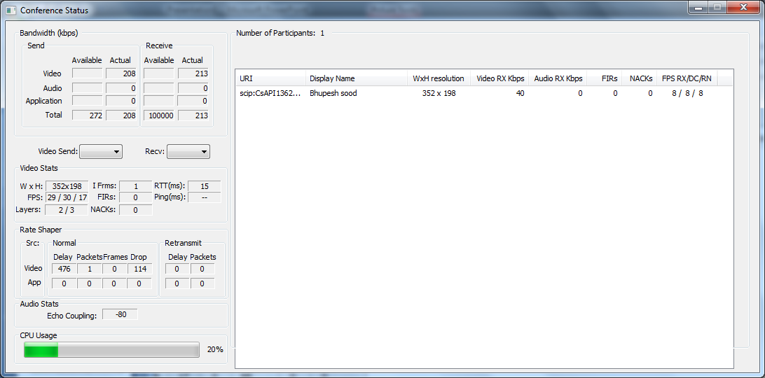
RateControl and Graceful Degradation
Due to limited uplink bandwidth, application downsamples Tx resolution
When Tx is further limited, we see Transmitted frames are dropped gracefully

Slide 37
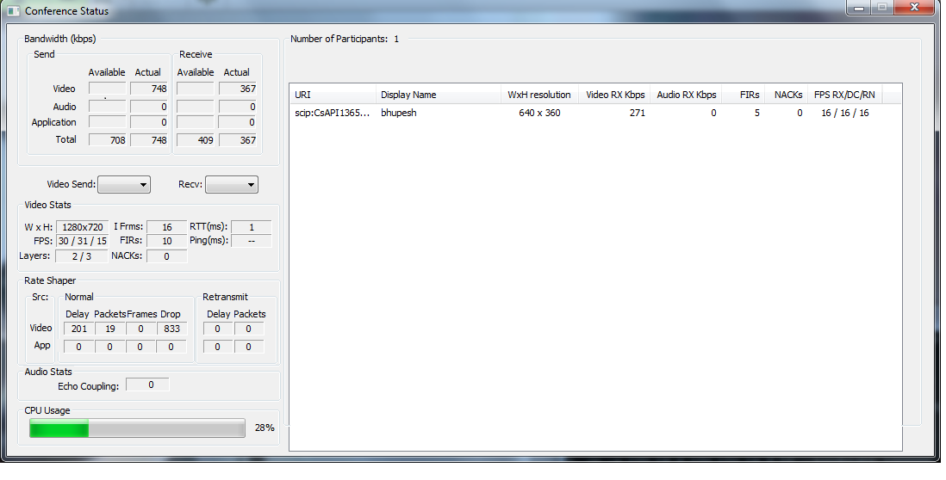
Graceful Degradation on Client and RateShaping on VidyoRouter
Due to limted Tx, Transmitted frames are dropped gracefully
Due to limited Downlink Bandwidth, VidyoRouter will send all Temporal layers and Spatial Base Layer

